Slide 1

HUL LIME XVI: Building for the Next Gen
Case Conqueror
Aman Kumar Sinha
Divyansh Kumar
Shibangi Paul

Slide 2
Hero Brand: Pepsodent
Summary of Consumer immersions:
Sample Size: 20 Persons Sample Selection method: Random, Convinience Occupation Status: Employed GenZs & Students Age Range: 20-27 Average Income of the Sample: INR 10,32,500
Top Consumer Trends:
Consumer verbatim reveals that they are preferring toothpaste that contains natural, eco-friendly and organic ingredients. It is was also revealed that they look out for toothpaste which is effective in sensitivity relief and teeth whitening, indicating a focus on oral health and aesthetics.
Online content, offline ads and social media influence purchasing decisions, while price sensitivity coexists with a willingness to pay more for quality and sustainable products.
Overall, trends show a growing connection between oral care, wellness, sustainability, and conscious consumerism.
Data to support the Consumer Trends:
The result from the survey and research is shown below in the excel sheet.
Customer data.xlsx
Super Consumer:
Super consumers prioritized sensitivity relief, whitening, and health benefits in toothpaste.
They seek eco-friendly, sustainable and natural products.
The Key triggers were product efficacy and ethical practices, while barriers were price sensitivity and skepticism about claims made by brands.
They value transparency and detailed digital content.
Communication Challenge: (100 words limit)
Existing Mindsets: Health-conscious, sustainable, value-oriented, and informed; prioritize oral wellness, natural product, sustainability, and transparency while balancing cost and quality.
Desired Mindsets: Prioritize complete dental health, long-term value, proactive sustainability, and innovation, integrating oral health with wellness and ethical standards.
Existing Behaviors: Research extensively online, prefer ethical and high-quality products, respond to promotions, and engage with digital content.
Desired Behaviors: Share transparent and informed reviews, show loyalty towards brands, support eco-friendly brands, stay updated on trends in health and sustainability.
The singular most important point that I want to convince my Super Consumer is Pepsodent caters to your every need with soothing sensitivity relief, brilliant whitening, and top-notch health benefits, all while championing eco-friendly practices.

Slide 3
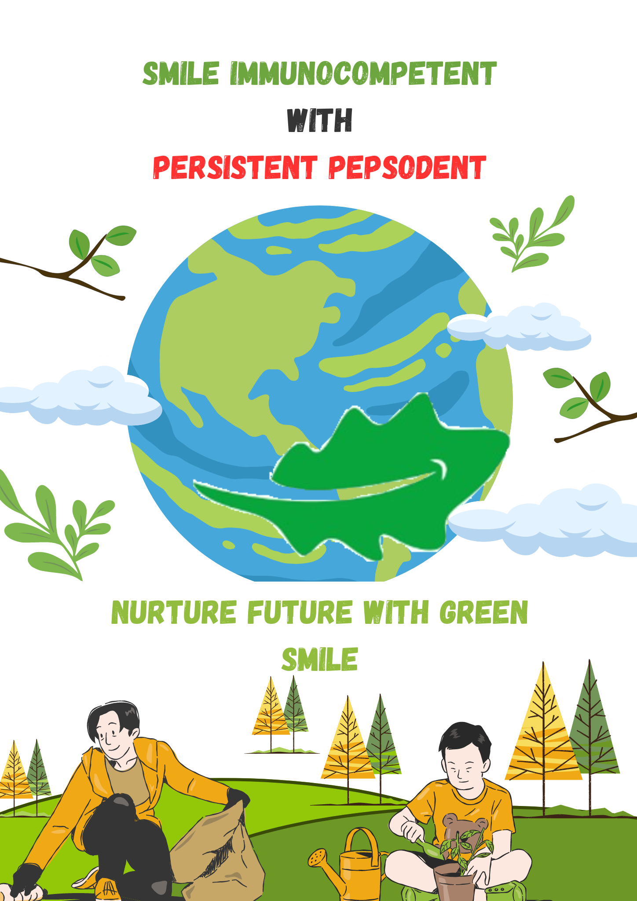
Consumer Insight (50 words limit)
Super consumers are health-conscious and value eco-friendly practices, they need products that enhance oral health and align with environmental sustainability. They compare proactively with other brands available, and they seek value without compromising on ethics, also they actively engage with digital content and online influencers. Their selection were influenced by online reviews and ad campaign which shows various benefits of the products.
Static Creative
Bring the Idea Alive (100 words limit)
Social Media: #ImmunocompetentSmile Challenge, Interactive filters and daily tips using platforms like Instagram, Facebook and X.
Influencers: Collaborate with micro-influencers, sports personalities, celebrities and renowned dentist of the country.
YouTube: Educational series and customer testimonials.
Website: Selling on Marketplace like Amazon and Flipkart, Smile tracker and oral health quiz for engagement.
Email and Newspaper: Monthly newsletters with tips and exclusive offers along with pamphlets in newspaper.
In-Store: Free samples and Smile Stations.
Billboards: Dynamic ads promoting “Immunocompetent Smiles”.
Workshops: Oral health drives and NGO partnerships in various cities.
AR and VR through app and website: Visualize Pepsodent's protective power with the help of AR and VR.
Dental Clinics: Promotions and discounts on Pepsodent products.
A”Green Smile” The Smile which comes when you contribute towards the sustainability

